Slide 1
Chapter 2
Process Management
Operating System Concepts

Slide 2
Process Concept
Process Scheduling
Operations on Processes
Cooperating Processes
Interprocess Communication (IPC)
Communication in Client-Server Systems
Operating System Concepts

Slide 3
Process Concept
An operating system executes a variety of programs:
  Batch system – jobs
  Time-shared systems – user programs or tasks
Textbook uses the terms job and process almost interchangeably.
Process – a program in execution; process execution must progress in sequential fashion.
A process includes:
  program counter
  stack
  data section
Operating System Concepts

Slide 4
Process State
As a process executes, it changes state
  new: The process is being created.
  running: Instructions are being executed.
  waiting: The process is waiting for some event to occur.
  ready: The process is waiting to be assigned to a process.
  terminated: The process has finished execution.
Operating System Concepts

Slide 5

Diagram of Process State
Operating System Concepts

Slide 6
Process Control Block (PCB)
Information associated with each process.
Process state
Program counter
CPU registers
CPU scheduling information
Memory-management information
Accounting information
I/O status information
Operating System Concepts

Slide 7

Process Control Block (PCB)
Operating System Concepts

Slide 8

CPU Switch From Process to Process
Operating System Concepts

Slide 9
Process Scheduling Queues
Job queue – set of all processes in the system.
Ready queue – set of all processes residing in main memory, ready and waiting to execute.
Device queues – set of processes waiting for an I/O device.
Process migration between the various queues.
Operating System Concepts

Slide 10

Ready Queue And Various I/O Device Queues
Operating System Concepts

Slide 11

Representation of Process Scheduling
Operating System Concepts

Slide 12
Schedulers
Long-term scheduler (or job scheduler) – selects which processes should be brought into the ready queue.
Short-term scheduler (or CPU scheduler) – selects which process should be executed next and allocates CPU.
Operating System Concepts

Slide 13

Addition of Medium Term Scheduling
Operating System Concepts

Slide 14
Schedulers (Cont.)
Short-term scheduler is invoked very frequently (milliseconds) ⇒ (must be fast).
Long-term scheduler is invoked very infrequently (seconds, minutes) ⇒ (may be slow).
The long-term scheduler controls the degree of multiprogramming.
Processes can be described as either:
  I/O-bound process – spends more time doing I/O than computations, many short CPU bursts.
  CPU-bound process – spends more time doing computations; few very long CPU bursts.
Operating System Concepts

Slide 15
Optimization Criteria
Max CPU utilization
Max throughput
Min turnaround time
Min waiting time
Min response time
Operating System Concepts

Slide 16
Scheduling Criteria
CPU utilization – keep the CPU as busy as possible
Throughput – # of processes that complete their execution per time unit
Turnaround time – amount of time to execute a particular process
Waiting time – amount of time a process has been waiting in the ready queue
Response time – amount of time it takes from when a request was submitted until the first response is produced, not output (for time-sharing environment)
Operating System Concepts

Slide 17
Context Switch
When CPU switches to another process, the system must save the state of the old process and load the saved state for the new process.
Context-switch time is overhead; the system does no useful work while switching.
Time dependent on hardware support.
Operating System Concepts

Slide 18
Process Creation
Parent process create children processes, which, in turn create other processes, forming a tree of processes.
Resource sharing
  Parent and children share all resources.
  Children share subset of parent’s resources.
  Parent and child share no resources.
Execution
  Parent and children execute concurrently.
  Parent waits until children terminate.
Operating System Concepts

Slide 19
Process Creation
Principal events that cause process creation
System initialization
Execution of a process creation system
User request to create a new process
Initiation of a batch job

Slide 20
Process Creation (Cont.)
Address space
  Child duplicate of parent.
  Child has a program loaded into it.
UNIX examples
  fork system call creates new process
  exec system call used after a fork to replace the process’ memory space with a new program.
Operating System Concepts

Slide 21
Process Termination
Conditions which terminate processes
Normal exit (voluntary)
Error exit (voluntary)
Fatal error (involuntary)
Killed by another process (involuntary)

Slide 22

Processes Tree on a UNIX System
Operating System Concepts

Slide 23
Process Termination
Process executes last statement and asks the operating system to decide it (exit).
  Output data from child to parent (via wait).
  Process’ resources are deallocated by operating system.
Parent may terminate execution of children processes (abort).
  Child has exceeded allocated resources.
  Task assigned to child is no longer required.
  Parent is exiting.
    Operating system does not allow child to continue if its parent terminates.
    Cascading termination.
Operating System Concepts

Slide 24
Cooperating Processes
Independent process cannot affect or be affected by the execution of another process.
Cooperating process can affect or be affected by the execution of another process
Advantages of process cooperation
  Information sharing
  Computation speed-up
  Modularity
  Convenience
Operating System Concepts

Slide 25
Producer-Consumer Problem
Paradigm for cooperating processes, producer process produces information that is consumed by a consumer process.
  unbounded-buffer places no practical limit on the size of the buffer.
  bounded-buffer assumes that there is a fixed buffer size.
Operating System Concepts

Slide 26
Bounded-Buffer – Shared-Memory Solution
Shared data
      #define BUFFER_SIZE 10
      Typedef struct {
      . . .
      } item;
      item buffer[BUFFER_SIZE];
      int in = 0;
      int out = 0;
Solution is correct, but can only use BUFFER_SIZE-1 elements
Operating System Concepts

Slide 27
Bounded-Buffer – Producer Process
item nextProduced;
while (1) {
while (((in + 1) % BUFFER_SIZE) == out)
; /* do nothing */
buffer[in] = nextProduced;
in = (in + 1) % BUFFER_SIZE;
}
Operating System Concepts

Slide 28
Bounded-Buffer – Consumer Process
item nextConsumed;
while (1) {
while (in == out)
; /* do nothing */
nextConsumed = buffer[out];
out = (out + 1) % BUFFER_SIZE;
}
Operating System Concepts

Slide 29
Interprocess Communication (IPC)
Mechanism for processes to communicate and to synchronize their actions.
Message system – processes communicate with each other without resorting to shared variables.
IPC facility provides two operations:
  send(message) – message size fixed or variable
  receive(message)
If P and Q wish to communicate, they need to:
  establish a communication link between them
  exchange messages via send/receive
Implementation of communication link
  physical (e.g., shared memory, hardware bus)
  logical (e.g., logical properties)
Operating System Concepts

Slide 30
Implementation Questions
How are links established?
Can a link be associated with more than two processes?
How many links can there be between every pair of communicating processes?
What is the capacity of a link?
Is the size of a message that the link can accommodate fixed or variable?
Is a link unidirectional or bi-directional?
Operating System Concepts

Slide 31
Direct Communication
Processes must name each other explicitly:
  send (P, message) – send a message to process P
  receive(Q, message) – receive a message from process Q
Properties of communication link
  Links are established automatically.
  A link is associated with exactly one pair of communicating processes.
  Between each pair there exists exactly one link.
  The link may be unidirectional, but is usually bi-directional.
Operating System Concepts

Slide 32
Indirect Communication
Messages are directed and received from mailboxes (also referred to as ports).
  Each mailbox has a unique id.
  Processes can communicate only if they share a mailbox.
Properties of communication link
  Link established only if processes share a common mailbox
  A link may be associated with many processes.
  Each pair of processes may share several communication links.
  Link may be unidirectional or bi-directional.
Operating System Concepts

Slide 33
Indirect Communication
Operations
  create a new mailbox
  send and receive messages through mailbox
  destroy a mailbox
Primitives are defined as:
send(A, message) – send a message to mailbox A
receive(A, message) – receive a message from mailbox A
Operating System Concepts

Slide 34
Indirect Communication
Mailbox sharing
  P₁, P₂, and P₃ share mailbox A.
  P₁, sends; P₂ and P₃ receive.
  Who gets the message?
Solutions
  Allow a link to be associated with at most two processes.
  Allow only one process at a time to execute a receive operation.
  Allow the system to select arbitrarily the receiver. Sender is notified who the receiver was.
Operating System Concepts

Slide 35
Synchronization
Message passing may be either blocking or non-blocking.
Blocking is considered synchronous
Non-blocking is considered asynchronous
send and receive primitives may be either blocking or non-blocking.
Operating System Concepts

Slide 36
Buffering
Queue of messages attached to the link; implemented in one of three ways.
  1. Zero capacity – 0 messages
  Sender must wait for receiver (rendezvous).
  2. Bounded capacity – finite length of n messages
  Sender must wait if link full.
  3. Unbounded capacity – infinite length
  Sender never waits.
Operating System Concepts

Slide 37
Client-Server Communication
Sockets
Remote Procedure Calls
Remote Method Invocation (Java)
Operating System Concepts

Slide 38
Sockets
A socket is defined as an endpoint for communication.
Concatenation of IP address and port
The socket 161.25.19.8:1625 refers to port 1625 on host 161.25.19.8
Communication consists between a pair of sockets.
Operating System Concepts

Slide 39

Socket Communication
Operating System Concepts

Slide 40
Remote Procedure Calls
Remote procedure call (RPC) abstracts procedure calls between processes on networked systems.
Stubs – client-side proxy for the actual procedure on the server.
The client-side stub locates the server and marshalls the parameters.
The server-side stub receives this message, unpacks the marshalled parameters, and peforms the procedure on the server.
Operating System Concepts

Slide 41

Execution of RPC
Operating System Concepts

Slide 42
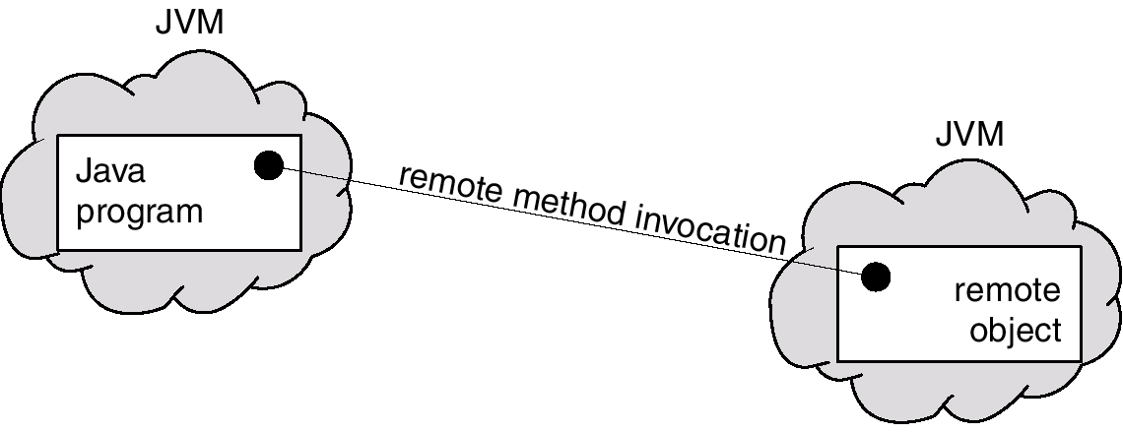
Remote Method Invocation
Remote Method Invocation (RMI) is a Java mechanism similar to RPCs.
RMI allows a Java program on one machine to invoke a method on a remote object.
Operating System Concepts

Slide 43
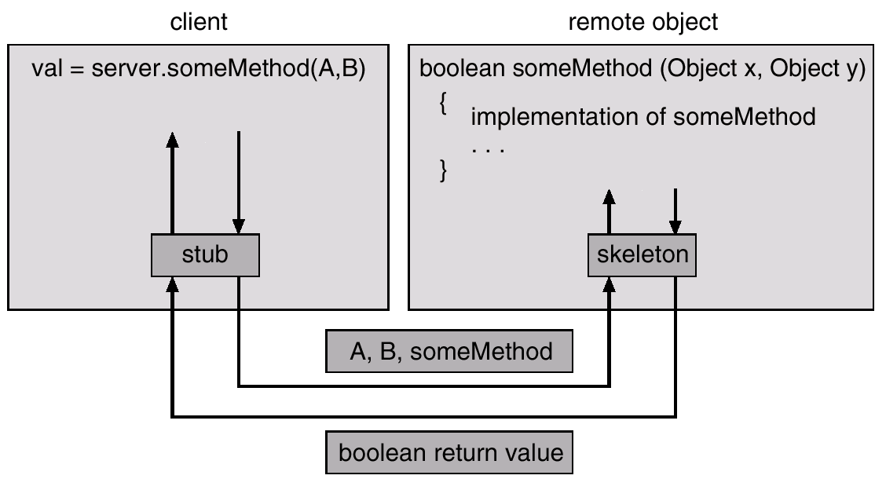
Marshalling Parameters
Operating System Concepts

